Slide 1

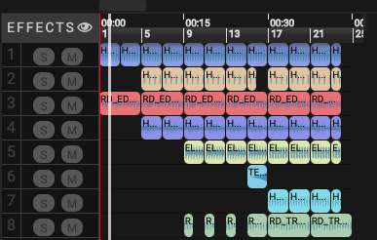
earsketch
Dannie James Jr.
My goal with this project is to take files that I created via code in Earsketch and repurpose them for a complete track in Logic Pro X.
https://github.com/danniejamesjr/Earsketch.git

Slide 2
My goal is to take files that I created in Earsketch and repurpose them for a complete track in Logic Pro X.

